Slide 1
Loan Default Prediction
Prediction Methods - Neural Networks

Slide 2
Contents / Agenda
Business Problem Overview & Solution Approach
Data Dictionary
Exploratory Data Analysis (EDA) Results
Data Preprocessing
Model Performance Summary
Best Model Selection
Conclusions & Recommendations
Appendix / Screenshots

Slide 3
Data Dictionary
The data contains different attributes of customers’ loan and credit details. The detailed data dictionary is given below:
BAD: Whether the client defaulted on the loan (0 = No, 1 = Yes)
LOAN: Amount of loan approved
MORTDUE: Amount due on the existing mortgage
VALUE: Current value of the property
REASON: Reason for the loan request (HomeImp = Home Improvement, DebtCon = Debt Consolidation)
JOB: Type of job the applicant has (e.g., Manager, Self-employed)
YOJ: Years at present job

Slide 4
Data Dictionary
DEROG: Number of major derogatory reports (serious delinquency/late payments)
DELINQ: Number of delinquent credit lines (past due payments)
CLAGE: Age of the oldest credit line in months
NINQ: Number of recent credit inquiries
CLNO: Number of existing credit lines
DEBTINC: Debt-to-income ratio (all monthly debt payments divided by gross monthly income)

Slide 5
How to use this deck?
This slide deck serves as a comprehensive template for your project submission
Within this deck, you will come across various questions that are intended to test your ability to understand data visualizations, discover patterns / insights and postulate hypothesis. Think thoroughly and provide answers to these questions
You are encouraged to modify this deck as required, by replacing the questions with suitable answers
Please feel free to incorporate additional points if you deem necessary
Note: The data visualizations you see in this deck are obtained from RapidMiner

Slide 6
Business Problem Overview and Solution Approach
Please define the problem
Please mention the solution approach / methodology

Slide 7
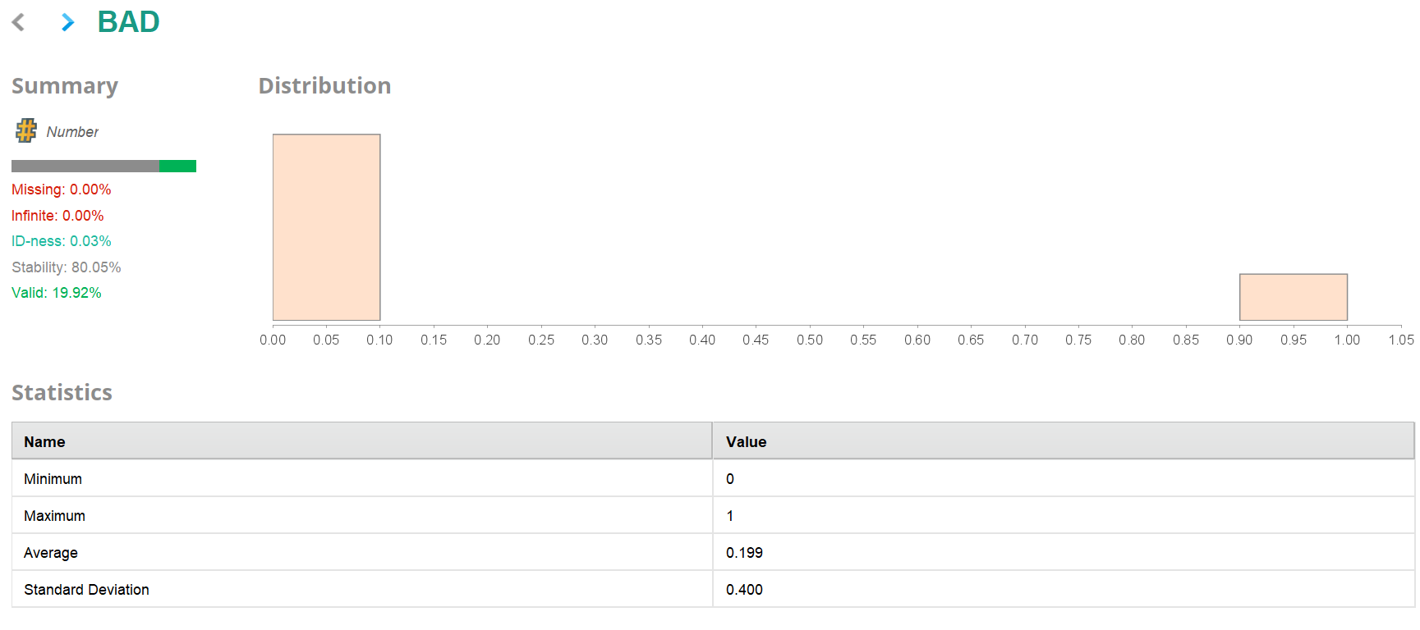
Statistics after Retrieve (Initial EDA):
At this stage, the statistics were used to understand the raw data before any modifications. This helped in identifying missing values, data types, and the overall distribution of features. It represents the initial univariate exploratory data analysis (EDA).

Slide 8
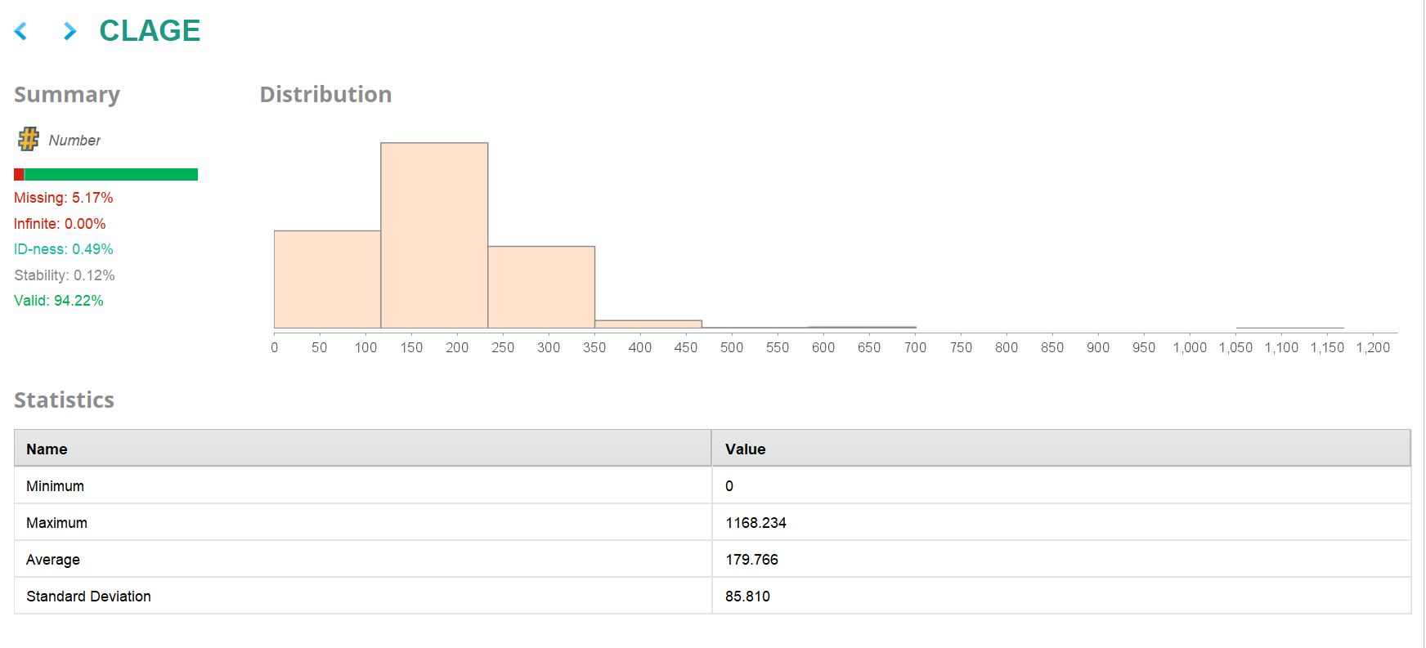

Slide 9
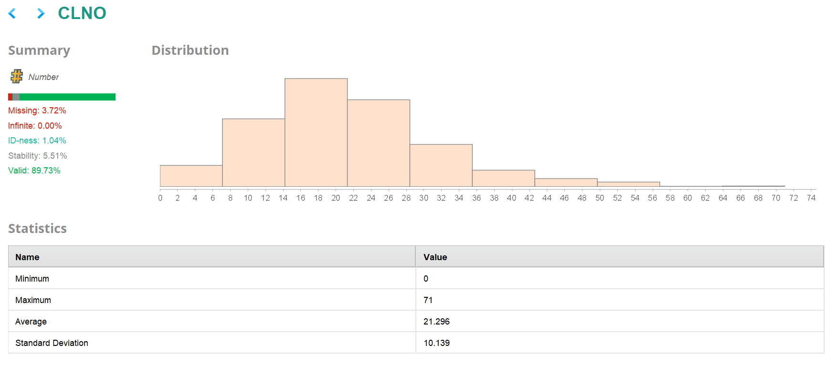

Slide 10
The Statistics give insights into different attributes of the dataset. We have shown the results for BAD, CLAGE, and CLNO to understand how these variables behave at each stage. Other attributes like DEBTINC, DELINQ, DEROG, JOB, LOAN, MORTDUE, NINQ, REASON, VALUE, and YOJ are also available in the dataset you can explore them in the same way using the Statistics operator to understand their patterns and values.
Add your insights and observations regarding the attributes you analyze in order to gain a deeper understanding of the data.

Slide 11
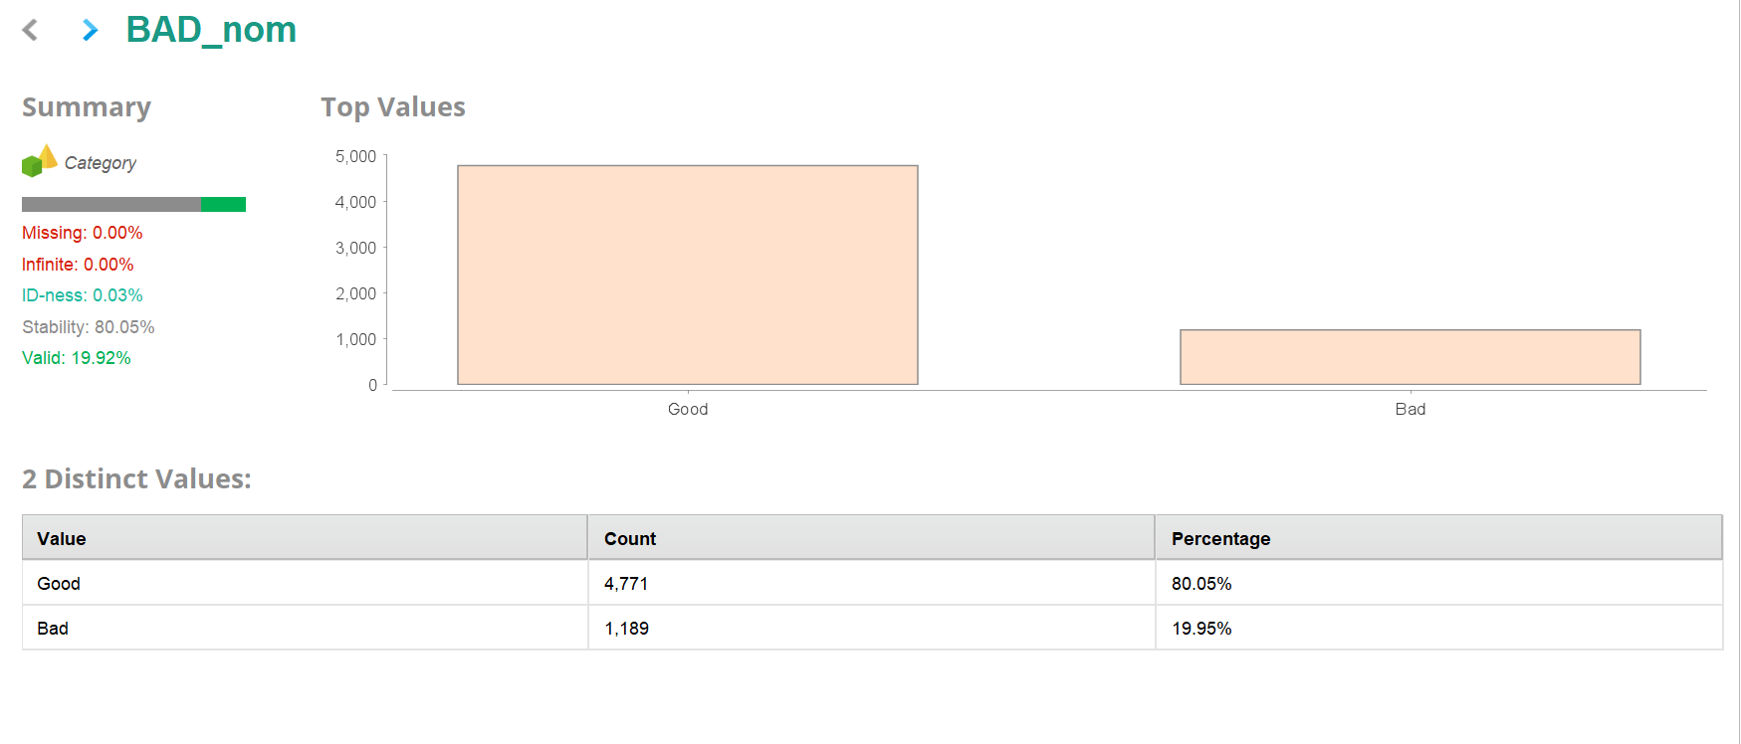
Statistics after Preprocessing:
After performing preprocessing steps such as missing value replacement, nominal-to-numerical conversion, and normalization, the statistics were again used to verify the changes and improvements. This helped confirm that data cleaning and transformations were applied correctly and that the dataset was now ready for modeling.

Slide 12
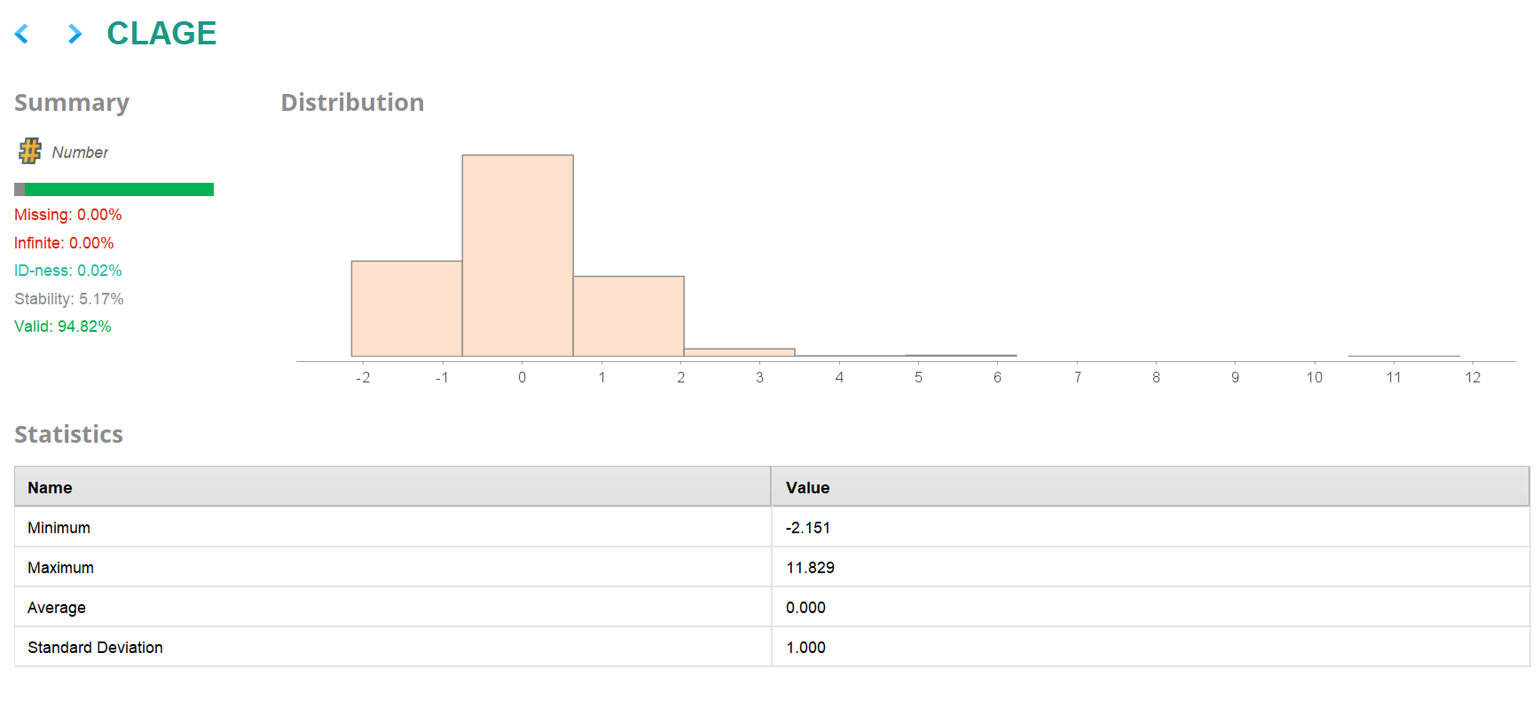

Slide 13
The Statistics give insights into different attributes of the dataset. We have shown the results for BAD_nom, CLAGE, and CLNO to understand how these variables behave after preprocessing. Other attributes like DEBTINC, DELINQ, DEROG, JOB_Mgr, JOB_Office, JOB_Other, JOB_ProfExe, JOB_Sales, JOB_Self, LOAN, MORTDUE, NINQ, REASON_DebtCon, REASON_HomeImp, VALUE, and YOJ are also available in the dataset - you can explore them in the same way using the Statistics operator to understand their patterns and values.
Add your insights and observations regarding the attributes you analyze in order to gain a deeper understanding of the data.

Slide 14
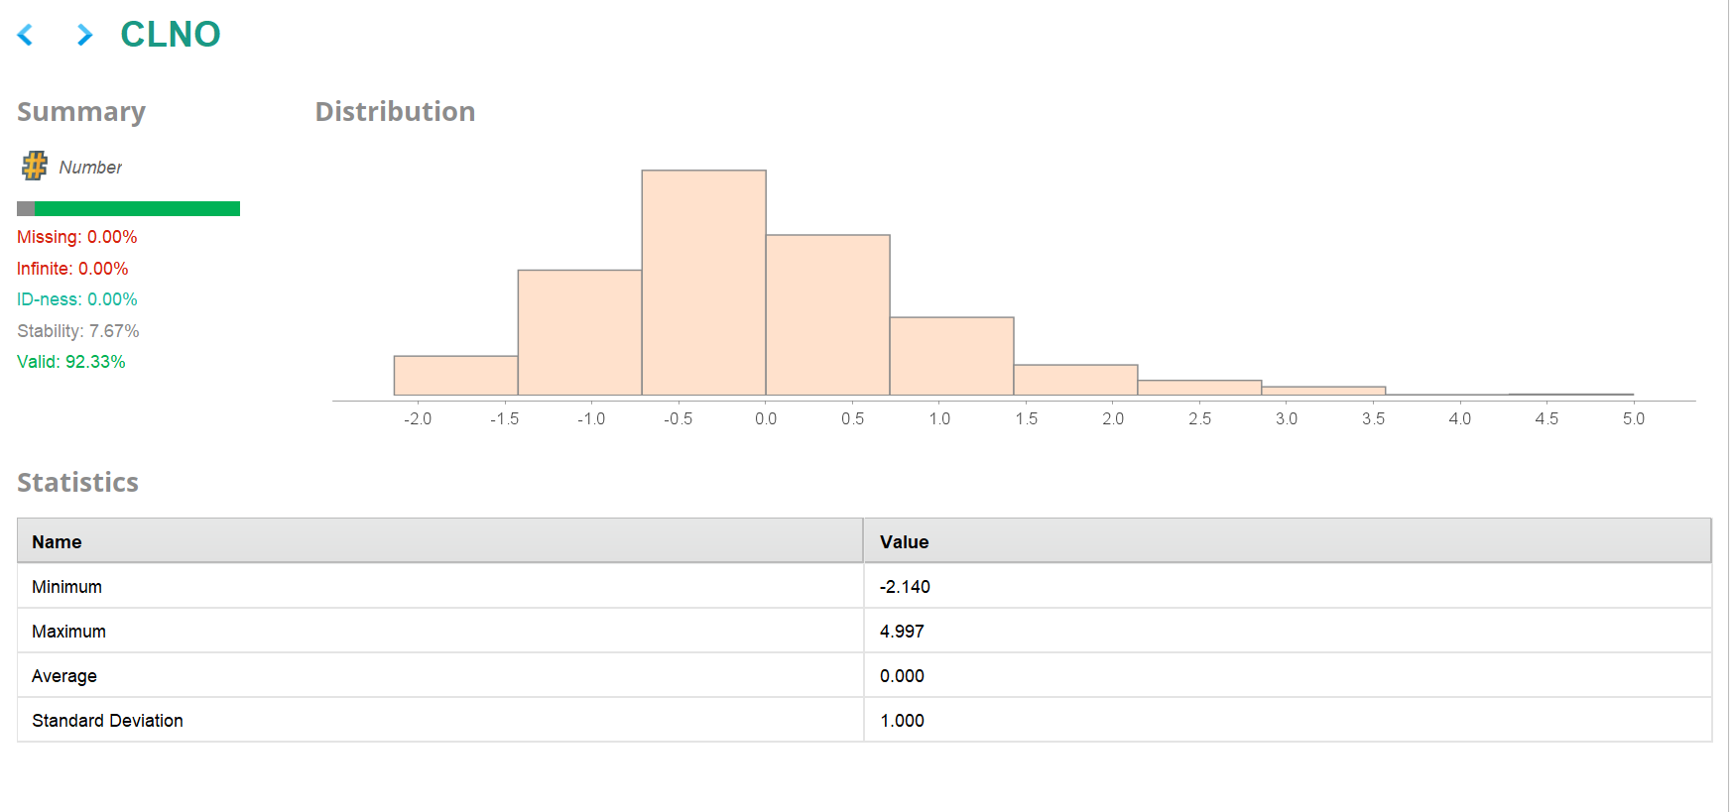

Slide 15
Scenario 1: Basic Neural Network
Please comment on the model performance
Metric | Accuracy | Kappa | Weighted Recall | Weighted Precision
Basic Neural Network | 84.96 | 0.507 | 74.20 | 76.71

Slide 16
Scenario 2: Neural Network With Parameter Tuning
Please comment on the model performance of the
Metric | Accuracy | Kappa | Weighted Recall | Weighted Precision
Neural Network with Parameter Tuning | 87.92 | 0.583 | 76.37 | 83.17

Slide 17
Scenario 3: Neural Network Using Grid Search
Please comment on the model performance
Metric | Accuracy | Kappa | Weighted Recall | Weighted Precision
Grid Search Optimized Model | 88.120 | 0.546 | 72.24 | 89.25

Slide 18
Model Performance Summary
Which model is best for predicting loan defaults, and which metric is most important to check? Why?
Which metric is most important, and why?
What advice would you give the business from this model?
Metric | Accuracy | Kappa | Weighted Recall | Weighted Precision
Without parameter tuning | 84.96 | 0.507 | 74.20 | 76.71
With parameter tuning | 87.92 | 0.583 | 76.37 | 83.17
Grid Search Optimized Model | 88.120 | 0.546 | 72.24 | 89.25

Slide 19
Conclusions and Recommendations
Please mention actionable insights & recommendations

Slide 20
APPENDIX

Slide 21
Slide Header
Please add any other pointers (if needed)

